Slide 1


P2P Network
SE3331-1 (2022 Fall)
IPADS, Shanghai Jiao Tong University
https://www.sjtu.edu.cn
xx

Slide 2
P2P Network

Slide 3
Downsides of Centralized Infrastructure(中心化架构)
Centralized point of failure(极易受到单点故障的影响)
High management costs
If one org has to host millions of files,(系统的可拓展性不好) etc.
Not suitable for many scenarios
E.g., cooperation between you and me(不适用各个节点之间等价的情况)
Lack ability to aggregate clients
本学期讲过的典型的中心化架构：
1.GFS(HDFS)，2.MapReduce，3.NFS....(其他的可能还有，想不起来了)

Slide 4
P2P (Peer-to-peer): No central servers!
How to track nodes and objects in the system?
How do you find other nodes in the system?
How should data be split up between nodes?
How to prevent data from being lost?
How to keep it available?
How to provide consistency?
How to provide security? anonymity?
“人人为我，我为人人”

Slide 5
BitTorrent(BT)
Usage Model: Cooperative
User downloads file from someone using simple user interface
While downloading, BitTorrent serves file also to others
BitTorrent keeps running for a little while after download completes
3 Roles
Tracker: What peer serves which parts of a file
Seeder: Own the whole file
Peer: Turn a seeder once has 100% of a file
tracker:作用类似于GFS中的master，存储的是各个节点的”metadata”.但是BT的架构是去中心的。
Notes:
** Challenges:
Tracking which peer has what
Handling high churn rates
Download rate proportional to upload rate

Slide 6
BitTorrent
问题1:去中心情况下如何知道哪个是tracker，即去那里获取元数据:通过.torrent中的URL。
Publisher a .torrent file on a Web server (e.g., suprnova.org)
URL of tracker, file name, length, SHA1s of data blocks (64-512Kbyte)
Tracker
Organizes a swarm(一群) of peers (who has what block?)
Seeder posts the URL for .torrent with tracker
Seeder must have complete copy of file
Peer asks tracker for list of peers to download from
Tracker returns list with random selection of peers
Peers contact peers to learn what parts of the file they have etc.
Download from other peers

Slide 7
A torrent file
{ 'announce': 'http://bttracker.debian.org:6969/announce',
'info': {
'name': 'debian-503-amd64-CD-1.iso',
'piece length': 262144, 'length': 678301696, 'pieces':
'841ae846bc5b6d7bd6e9aa3dd9e551559c82abc1...d14f1631d
776008f83772ee170c42411618190a4'
}
}

Slide 8
Which Piece to Download?
Different policies: Order of parts downloading
Strict?
Rarest first?
Random?
Parallel?
BitTorrent
Random for the first one(第一块随机下载,使得下载尽快开始)
Rarest first for the rest(中间的块挑选被下载的数量(备份数量)最小的去下载)
Parallel for the last one(最后一块下载速度普遍较慢,最好多个peer并行下载)
parallel下载最后一块类似于MapReduce中的redundant execution。
strict:
rarest first: ensures that every piece is widely available also helps with the seed and bootstrapping rapidly and won't retrieve the same piece multiple times from the seed
random:avoid overloading seed when starting download if peer has no piece, get as quickly as possible a piece so that it can upload don't use rarest because it is likely only one peer has it
--> use random, can download subpieces in parallel
parallel download of same pieces:avoid waiting on slowest
Notes:
strict?
rarest first?
ensures that every piece is widely available
also helps with the seed and bootstrapping rapidly
won't retrieve the same piece multiple times from the seed
random?
avoid overloading seed when starting download
if peer has no piece, get as quickly as possible a piece so that it can upload
don't use rarest because it is likely only one peer has it
--> use random, can download subpieces in parallel
parallel download of same pieces?
avoid waiting on slowest

Slide 9
Drawback of BitTorrent
Rely on Tracker
Tracker is central component
Cannot scale to large number of torrents

Slide 10
Scalable Lookup: DHT
DHT: Distributed hash table
Used to find the node responsible for a key quickly(不同于直接搜索这个key)
Distributed index: each node keeps a subset of the index
Typical DHT interface:
put(key, value)
get(key) -> value
Loose guarantees about keeping data alive
同样是已知当前节点，通过某种手段去找到下一个要到达的节点，所以也是一种route
Notes:
Two options: find the data, find the node ID, who knows the data. focus on the latter.

Slide 11
P2P Implementation of DHT
Overlay Network
Partition hash table over n nodes
Not every node knows about all other n nodes
Route to find right hash table
Goals
log(n) hops
Guarantees about load balance

Slide 12
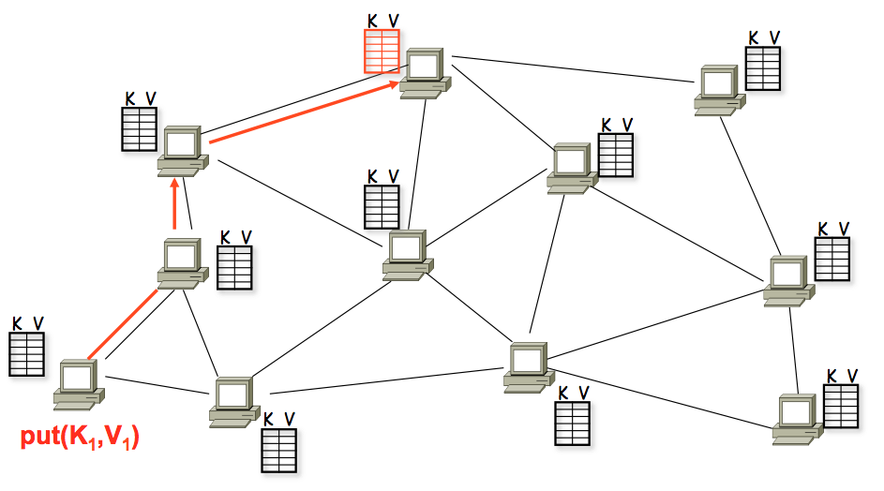
A DHT in Operation: put()
这张图片中红色路径就类似于route table中存储的那个路径。并且每个节点只存储下一个要到达的节点
recall：path vector。

Slide 13
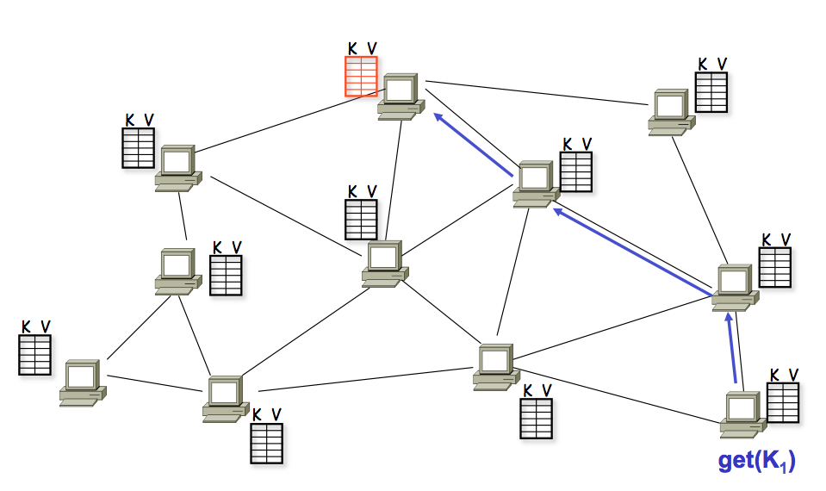
A DHT in Operation: get()

Slide 14
Chord Properties
Efficient: O(log(N)) messages per lookup
N is the total number of servers
Scalable: O(log(N)) state per node
Robust(安全性，健壮性): survives massive failures

Slide 15
Chord IDs
Key identifier = SHA-1(key)
SHA-1 is a hash function
Node identifier = SHA-1(IP address)
Both are uniformly distributed
Both exist in the same ID space
How to map key IDs to node IDs? by mod?
SHA-1算法保证了SHA-1(key)和SHA-1(IP)可以位于同一个值域范围内，这就保证了可以通过**比较**某个key和某个node对应的SHA-1结果来判断这个key是否位于这个node中。
但是实际上并不是每个key都一定对应于一个同编号的node，所以需要下一页PPT提到的结构来进行映射。

Slide 16
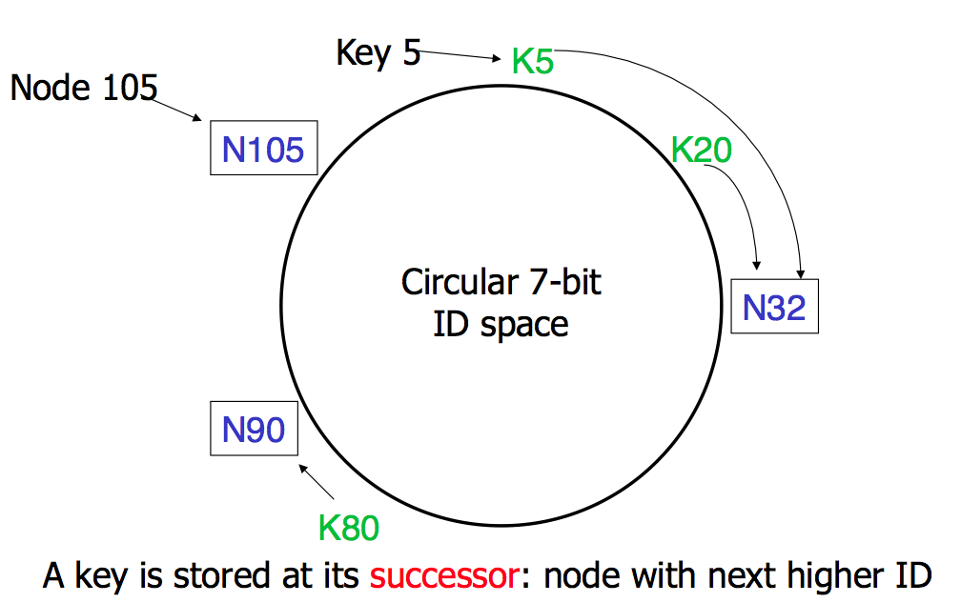
Consistent Hashing
这个圆圈就是表示前面提到的相同的ID space。
每个key的存储原则：若存在ID相同的node，则直接存入；若不存在，则存入最近的一个后继node。所以图中的K5就应该存储在N32。
这个值域的数值变化规则：顺时针旋转，数值在**一圈之内**越来越大。

Slide 17
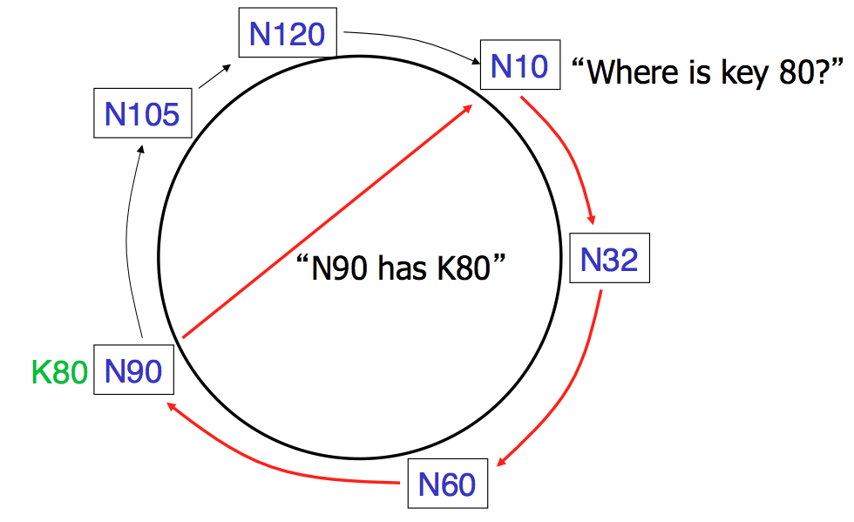
Basic Lookup
Lookup算法(线性复杂度):从起点开始，去寻找第一个NID>=KID的对应的node，那么这个key就应该存储在这个node中。(在这个node没有crash的情况下)。

Slide 18
Simple Lookup Algorithm
Lookup(my-id, key-id)
n = my successor
if my-id < n < key-id
call Lookup(id) on node n // next hop
else
return my successor // done
Correctness depends only on successors

Slide 19
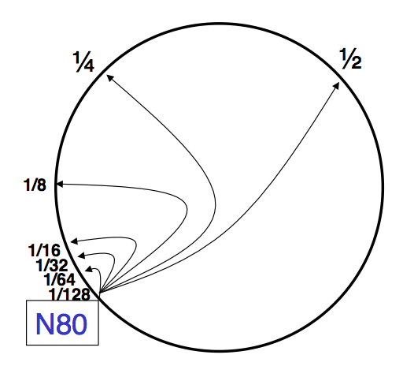
"Finger Table" allows log(N) lookups

Slide 20
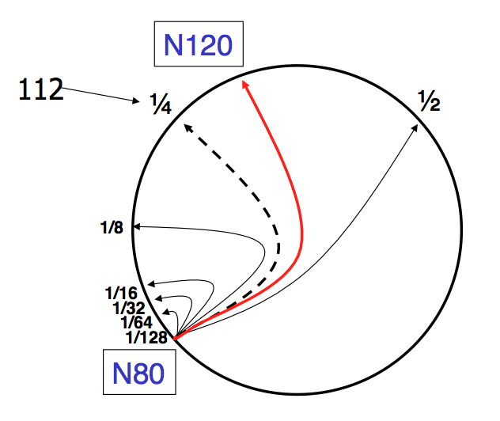
Finger i points to successor of n+2^{i}

Slide 21
Lookup with fingers
Lookup(my-id, key-id)
look in local finger table for
highest node n s.t. my-id < n < key-id
if n exists
call Lookup(id) on node n // next hop
else
return my successor // done

Slide 22
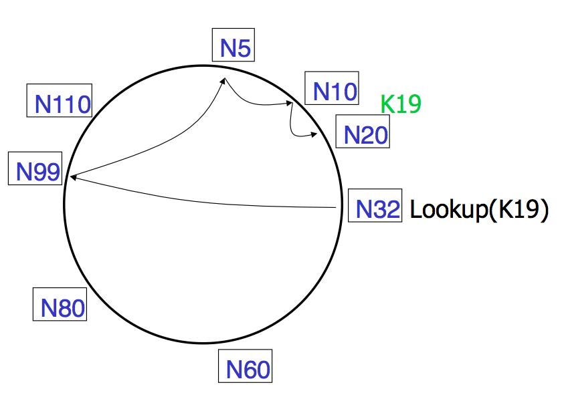
Lookups take O(log(N)) hops
N32要查找K19，19<32,说明在下一圈才能找到。首先查找N32的table，找到了最大的N99(注意取模，因为每一圈是一个循环)，从N99开始查找table，发现了N5，因为下一个N32就大了，之后在N5找到了N10，N10发现下一个节点就是N20>19,所以直接返回后继节点N20，结束。

Slide 23
Failures might cause incorrect lookup
N120
N10
N113
^{Lookup(90)}
在左图情况中，应该直接去找N80的后继，因为N85,N102都crash了，所以finger table中最小的一个N113已经超过K90了，但是N80并不知道自己的successor！
N102
N85
N80
N80 doesn't know correct successor, so incorrect lookup

Slide 24
Solution: successor lists
Successor Lists
Each node knows r immediate successors
After failure, will know first live successor
Correct successors guarantee correct lookups
Guarantee is with some probability

Slide 25
Join (1)
N25
N36
1. Lookup(36)
N40
K30
K38

Slide 26
Join (2)
N25
N36
1. Lookup(36)
N40
K30
K38

Slide 27
Join (3)
N25
N36
K30
1. Lookup(36)
N40
K30
K38

Slide 28
Join (4)
N25
4. Set N25's successor pointer
N36
K30
N40
K30
K38
数据移动量很少，因为ID space不变，变化的只有一个机器管理的数据范围，追需要把变化范围的数据移动到新节点就行了。
Update finger pointers in the background

Slide 29
Solution: successor lists
Successor List Length
Assume 1/2 of nodes fail
P(successor list all dead) = (1/2)^{r}
I.e. P(this node breaks the Chord ring)
Depends on independent failure
P(no broken nodes) = (1 – (1/2)^{r})^{N}
r = 2log(N) makes prob. = 1 – 1/N

Slide 30
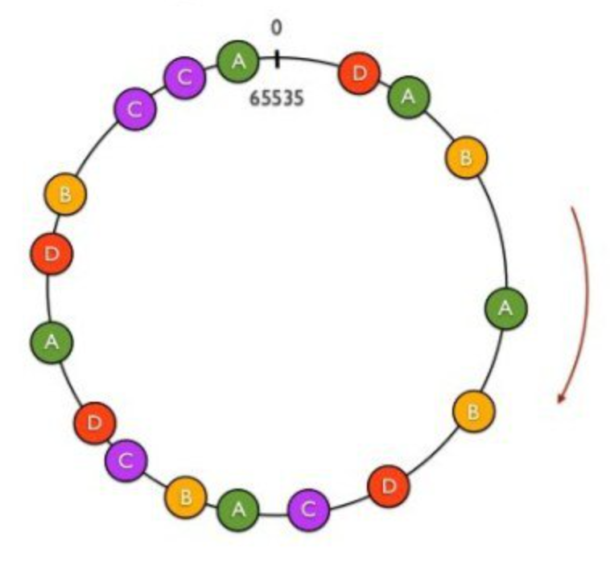
Virtual Nodes for Load Balance
Load balance could be a problem
Some nodes have most value
Solution: virtual nodes
Virtual nodes are distributed across the ring
One physical node can have multiple virtual nodes
More virtual nodes, better load balance
1.virtual node是逻辑概念，因而一个物理节点在同一个ID space中可以拥有多个。
2.virtual node的作用是将一些load较小的节点的virtual node放入一些load比较大的节点中间，来分摊一些load，从而使得负载尽可能的均衡。(recall:join)

Slide 31
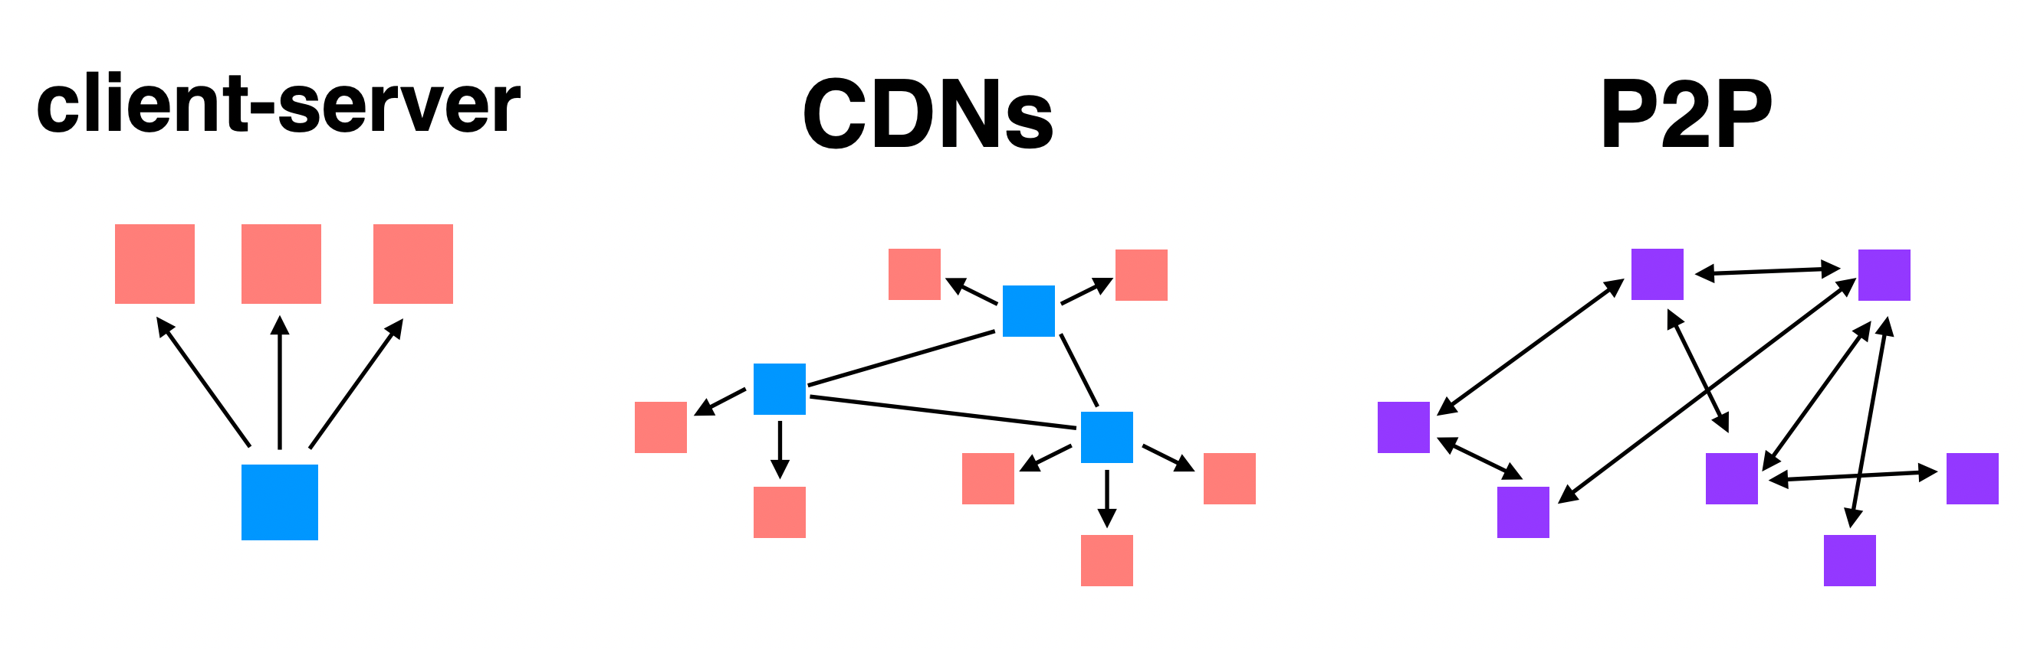
Summary: Different File Sharing Techniques

Slide 32
Bitcoin & Blockchain

Slide 33
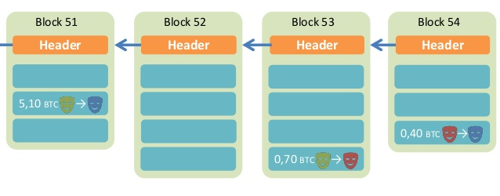
Overview of BitCoin
在下图中的链表中,每个header存储的是前面一个block的对应的TX的一个hash值，当前一个TX对应的消息被篡改的时候，后面的节点会发现被修改了，因而人为的修改TX的数据是不可行的。
BitCoin is a decentralized public-accessable ledger
Using hashes as a pointers, which form a chain
Tamper-proof (assuming 51% honest)
区块链只会保留最长的一条链。
所有操作都是匿名操作，只会通过公钥私钥。
Time

Slide 34
What is Crypto-Concurrency?
一个管理者(矿工)如何判断一个TX是否合法：
1.首先这个管理者会将这个TX的发起者对应的所有block chain信息下载到本地并redo一次；2.之后会检查redo之后的结果是否符合新的TX的要求，如余额是否充足等。3.若非法，则不会被添加到chain中。即使添加到chain中，也不会有majority的node接收，因为大家会发现这个TX是非法的。
A ledger(账本) recording all the money
Why double-spending is possible?
Y creates two transactions for same coin: Y->Z, Y->Q
both with hash(T7)
Y shows different transactions to Z and Q
both transactions look good, including signatures and hash
now both Z and Q will give hamburgers to Y
How to avoid double-spending?
即使一个TX发起者强制将一个非法的TX放入自己的block中，也不会真正被执行，因为最终只会保留最长的一条链，而其余的node在执行这个block的时候会发现是非法的，所以就不会将这个block添加到自己的chain中，所以最终的最长链中就不会有这个block，因而也不会被最终接收。
double spending：即一笔钱被花了两次。对于Y->Q,Y->Z，有三种情况：1.majority都先处理了Y->Q，这样Y->Z就会被拒绝;2.majority都先处理了Y->Z，这样Y->Q就会被拒绝掉;3.各有一半的node分别处理了Y->Q和Y->Z，这样就会使得chains出现分支，但是根据block-chain最终只会保留最长链的规则，最终总会有一个TX被淘汰。
因而解决double spending的方式就是redo整条chain去检查是否成功提交。需要等待。

Slide 35
Phases in Blockchain
Proposal phase
Who to propose the block?
Validation phase
Who to validate the block?
Usually all the participants in the network
What if an attacker run multiple processes as fake nodes, in order to control 51% nodes?
每一个用户都会尽可能快的去收集资源构成block，加到自己的链里面，去变成最长的链。比如有10个人竞争，已经有10个block，其中一个人算出来3个block，那么其余的人就不然再算这三个了，直接认证，因为认证远比计算要快，所以直接从第14个开始计算。

Slide 36
Existing Solutions
通过设置一个要求比较严格的限制hash，来使得一个新的TX在准备加入block的时候需要通过nonce进行大量的运算，从而来降低chain长度的增加速度。
Proof of Work (PoW)
Brute force to solve a random number (nonce)
Inefficient, waste of resources
Satisfy the number of first 0s
Tx data
Compute
the
hash
Output
Timestamp
Nonce
Nonce++
PreHash

Slide 37
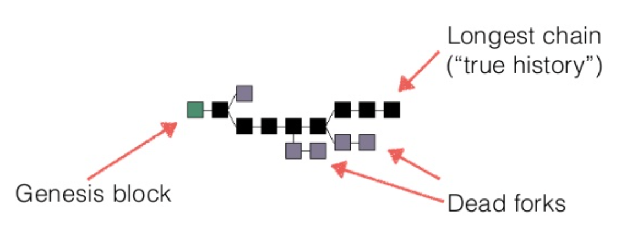
Trust the Majority
If a majority of CPU power is controlled by honest nodes, the honest chain will grow the fastest and outpace any competing chains
To modify a past block, an attacker would have to redo the proof-of-work of the block and all blocks after it and then catch up with and surpass the work of the honest nodes

Slide 38
Network Steps
1) New transactions are broadcast to all nodes.
2) Each node collects new transactions into a block.
3) Each node works on finding a difficult proof-of-work for its block.
4) When a node finds a proof-of-work, it broadcasts the block to all nodes.
5) Nodes accept the block only if all transactions in it are valid and not already spent.
6) Nodes express their acceptance of the block by working on creating the next block in the chain, using the hash of the accepted block as the previous hash.

Slide 39
Incentive(奖励，激励)
By convention, the first transaction in a block is a special transaction that starts a new coin owned by the creator of the block
The incentive can also be funded with transaction fees
The incentive may help encourage nodes to stay honest
If a greedy attacker is able to assemble more CPU power than all the honest nodes, he ought to find it more profitable to play by the rules than to undermine the system and the validity of his own wealth

Slide 40
Questions
在BTC中，造假是不可能的。因为会通过hash的方式进行加密，而验证一个hash是否符合条件是远远简单于求出一个hash是符合条件的。而如果造假，会很快被其他人发现从而拒绝这个TX，从而使得BTC算力下降，从而使个人利益受损。
Can some one other than the owner spend a coin?
What if I lose my private key?
Is it possible to have inflation?
Is mining really decentralized?
Is it necessary to use PoW? It's a waste of power!
How can I get bitcoin?
1.不会，因为在BTC中，需要使用个人的私钥进行一个TX，所以其他人不能使用自己的BTC。
2.如果丢失了私钥，那么就会直接失去所有的BTC。
3.不可能。因为btC总量是有上限的，并且丢失私钥之后会直接丢失财产，所以只会通货紧缩而不会通货膨胀。
4.不一定。因为有的寡头可能占有过高的算力比率。
5.POW只是为了让系统慢下来。但是确实会浪费过多资源。

Slide 41
Smart Contract
指的是一个node不光存储一个TX信息，还可以“写代码”。既可以自动地通过这段代码得到一个新的TX。这种代码是由所有矿工共同执行的。这种代码必须要是具有结果确定性的。
The nodes not only store transactions, but also code
... and also execute the code to gen new transaction!
The code is known as "smart contract"
Execution can be triggered by events/invocations

Slide 42
Larger Storage
Store general data, instead of only transaction
Then a node needs to prove it does store the data
Proof of retrievability, in challenge-response form
Examples: IPFS, STORJ
一种验证一个数据是否还被存储的方式：
将数据随机分成几等分，每过相同时间就获取一个随机的hash，去要求存储数据的那台机器也去计算对应数据的hash，若每次都能对应的上，说明数据还在。但是这也并不能一定保证数据的完备性，因为hash计算还是有很小的概率会重复的。

Slide 43
Permissioned Chain
Bitcoin is a permission-less chain
Protect user's privacy by anonymity(匿名性，只需要公钥私钥)
Also hard to track
Permissioned chain is not anonymous
E.g., several companies build a chain used by themselves only
It is just a multi-manager distributed database, which has nothing new

Slide 44
It's all about Trust
Why blockchain?
We need a consensus for a ledger
There is no third party to be trusted
If there is someone trusted by all, then blockchain is not needed
Blockchain is slow and hard to use
It is designed to be that way
Considering the storage and bandwidth of the ledger

Slide 45
Questions
Why BitCoin is so valuable?
A bit-string itself does not worth anything
It is the consensus that matters
A decentralized global consensus is hard to achieve
Before BitCoin, it is even thought as impossible
BitCoin solves this problem by incentive. Human is in the loop!
How to ban BitCoin?

